Slide 1
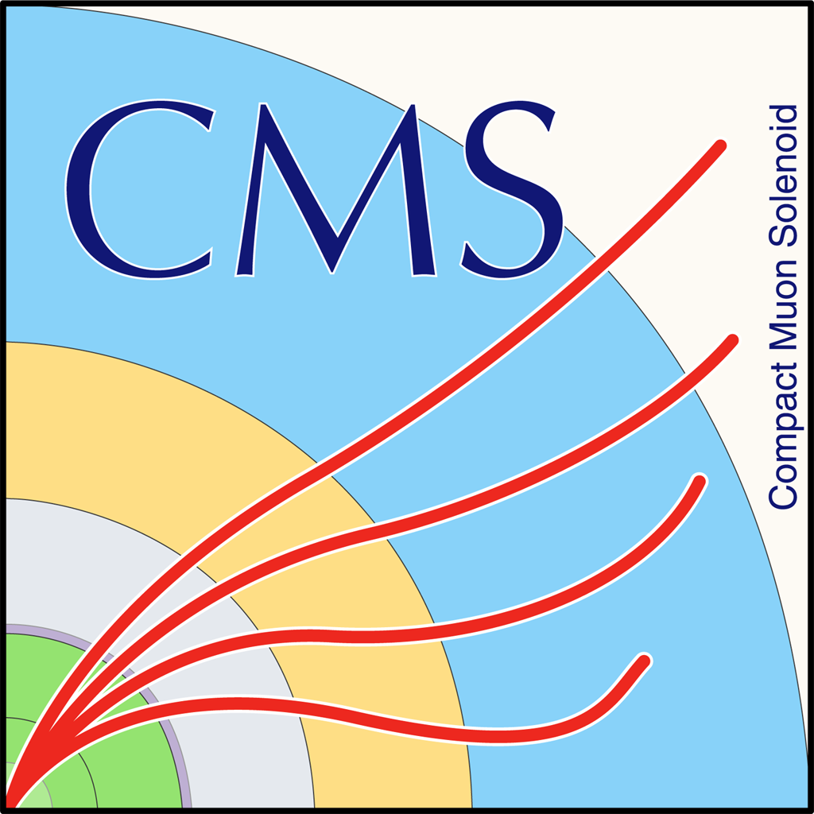
Is it the Higgs? Characterization of the H(125) resonance (spin, parity, tensor structure) with leptonic WW decays
Rebeca Gonzalez Suarez
University of Nebraska, Lincoln

Slide 2
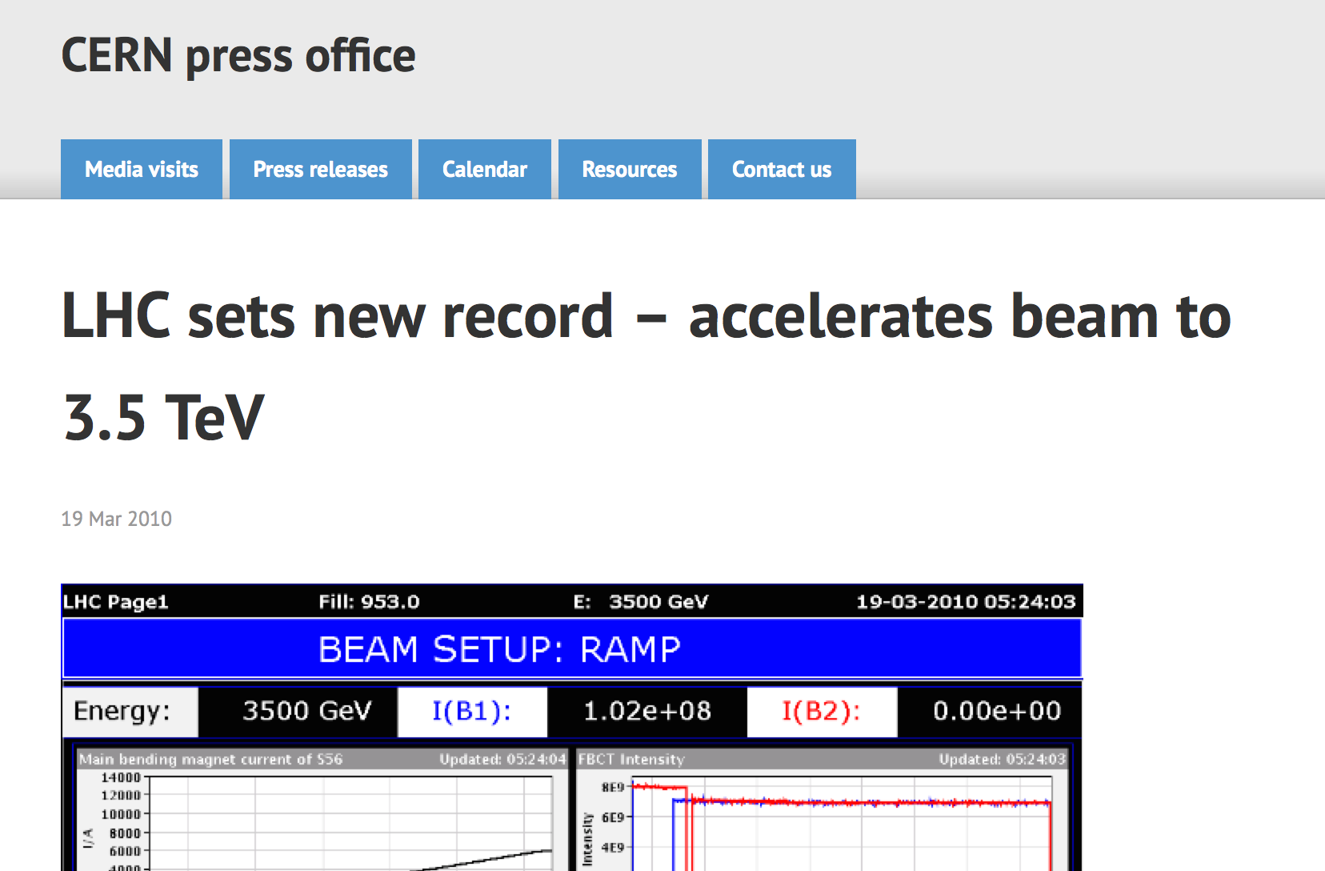
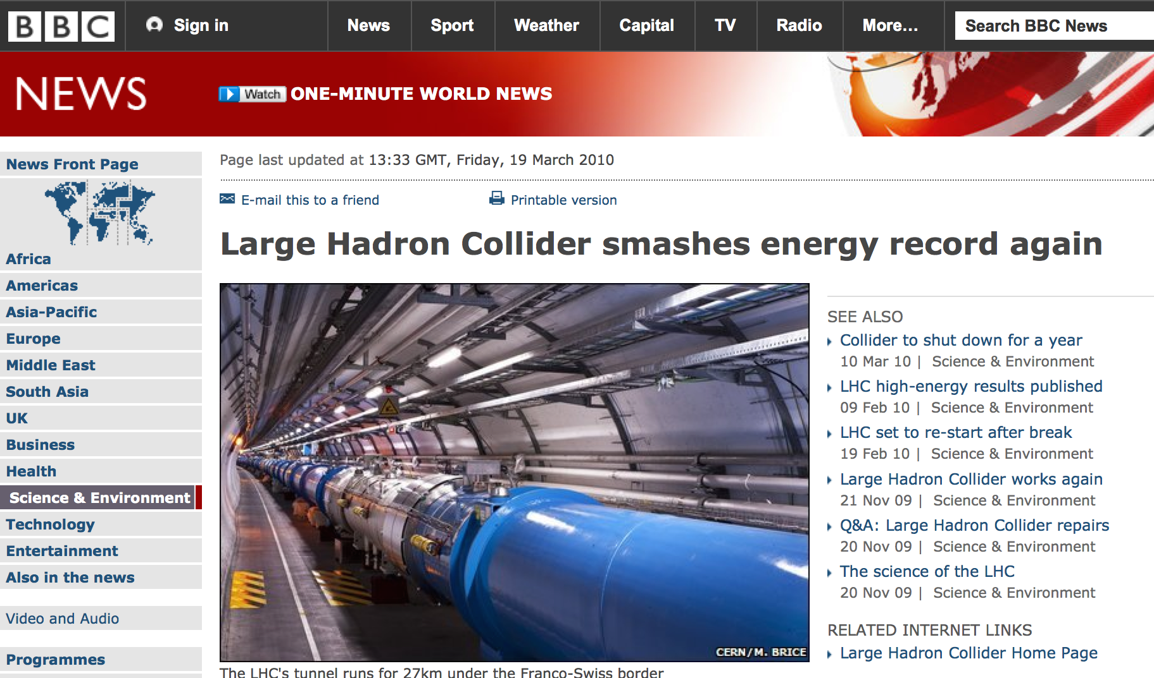
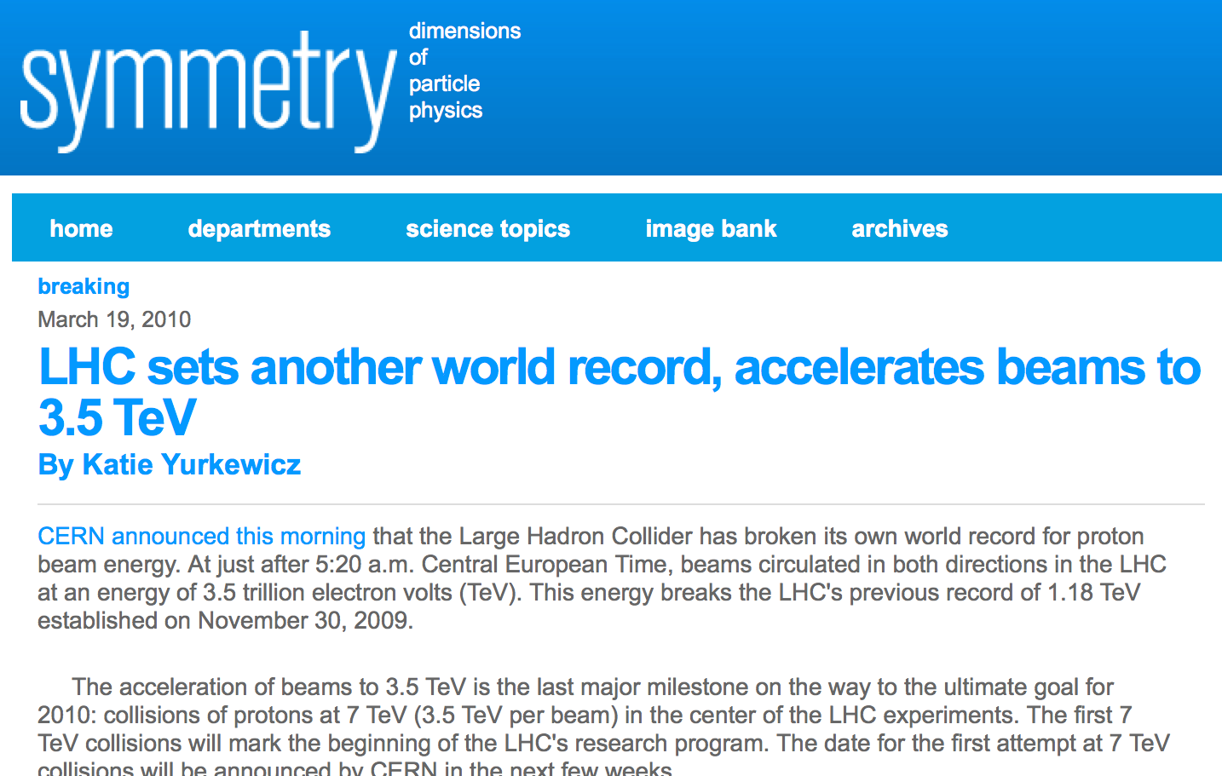
5 years ago Tomorrow
The LHC entered the 7TeV regime with 3.5TeV beams circulating (collisions to come in March 30th)
The Run-1 of the LHC was just starting

Slide 3
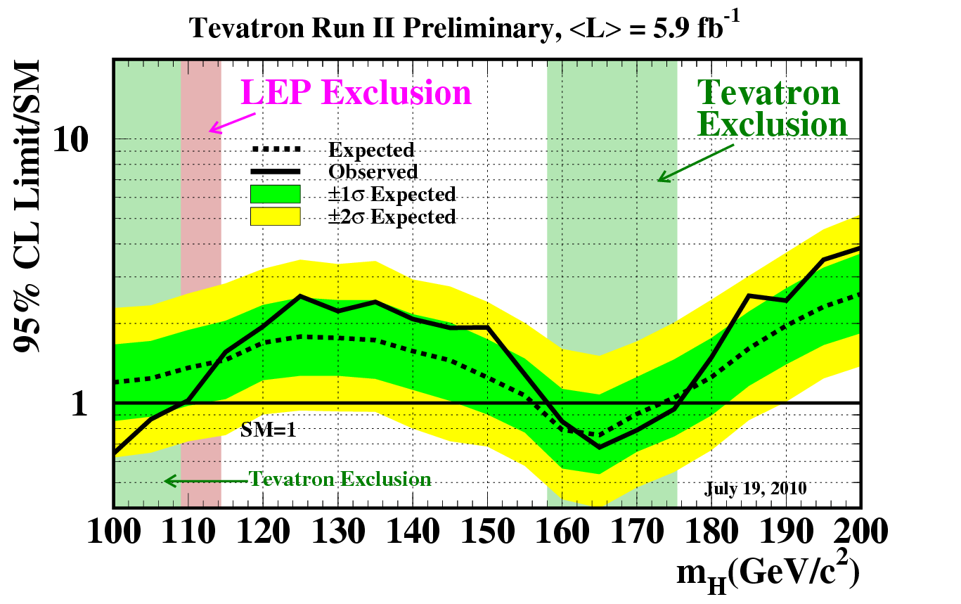
Higgs searches panorama in 2010
Simulation-based studies since the physics TDR in 2006
We were hoping to find the Higgs boson (or to exclude its presence in the intermediate mass range) in a reasonable timescale, this was our roadmap

Slide 4
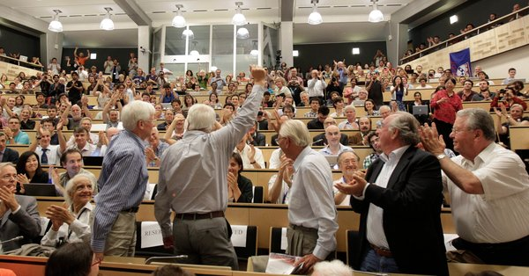
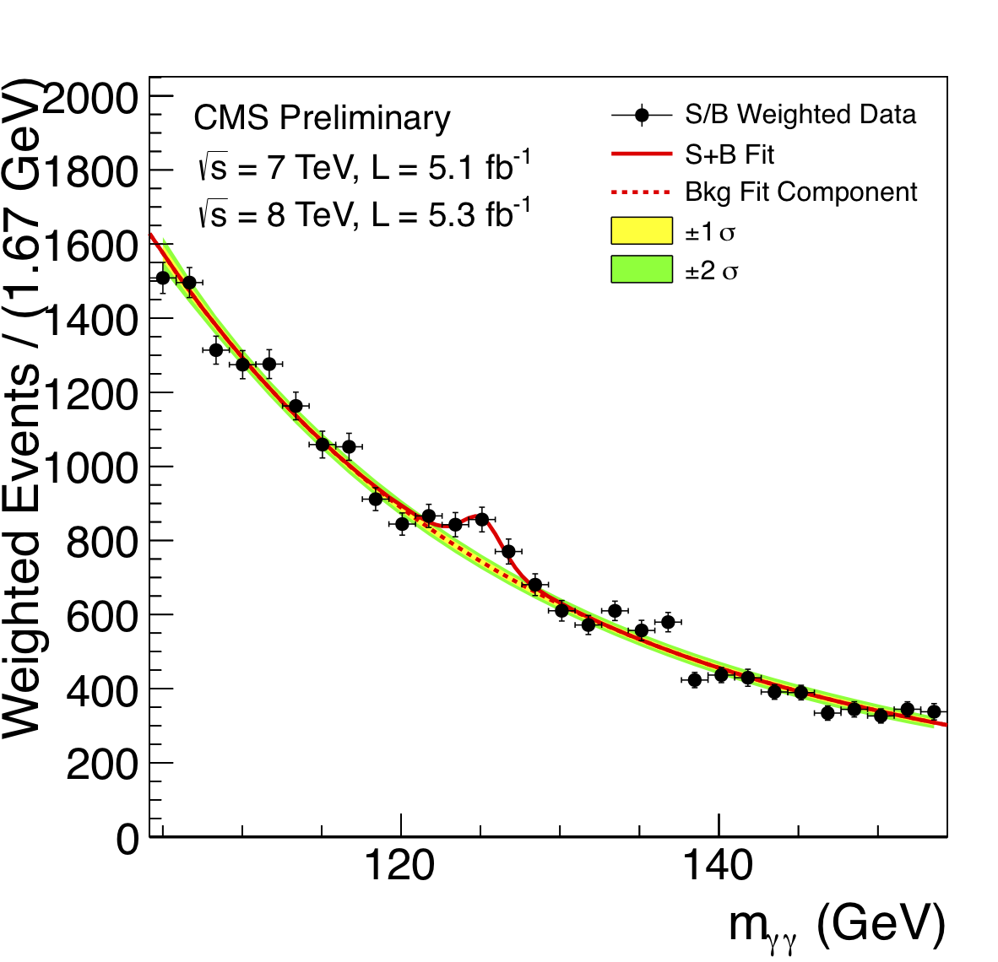
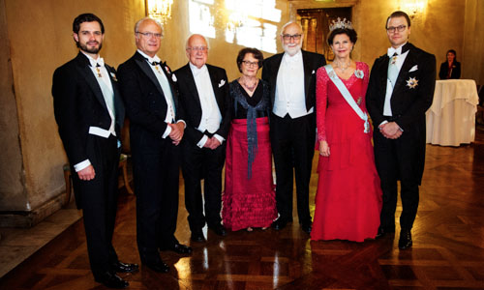
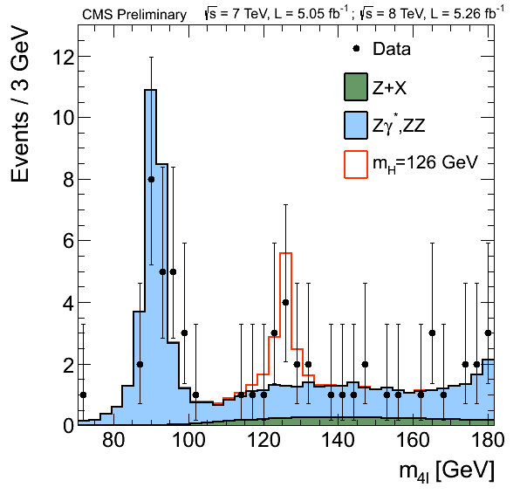

Higgs searches panorama in 2012
arXiv:1207.7235
Phys. Lett. B 716 (2012) 30
(Submitted 31 July 2012)
arXiv:1303.4571
JHEP 06 (2013) 081
(Submitted 19 March 2013)
CMS discovery papers

Slide 5
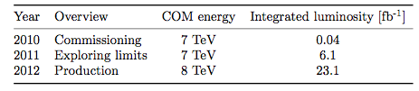
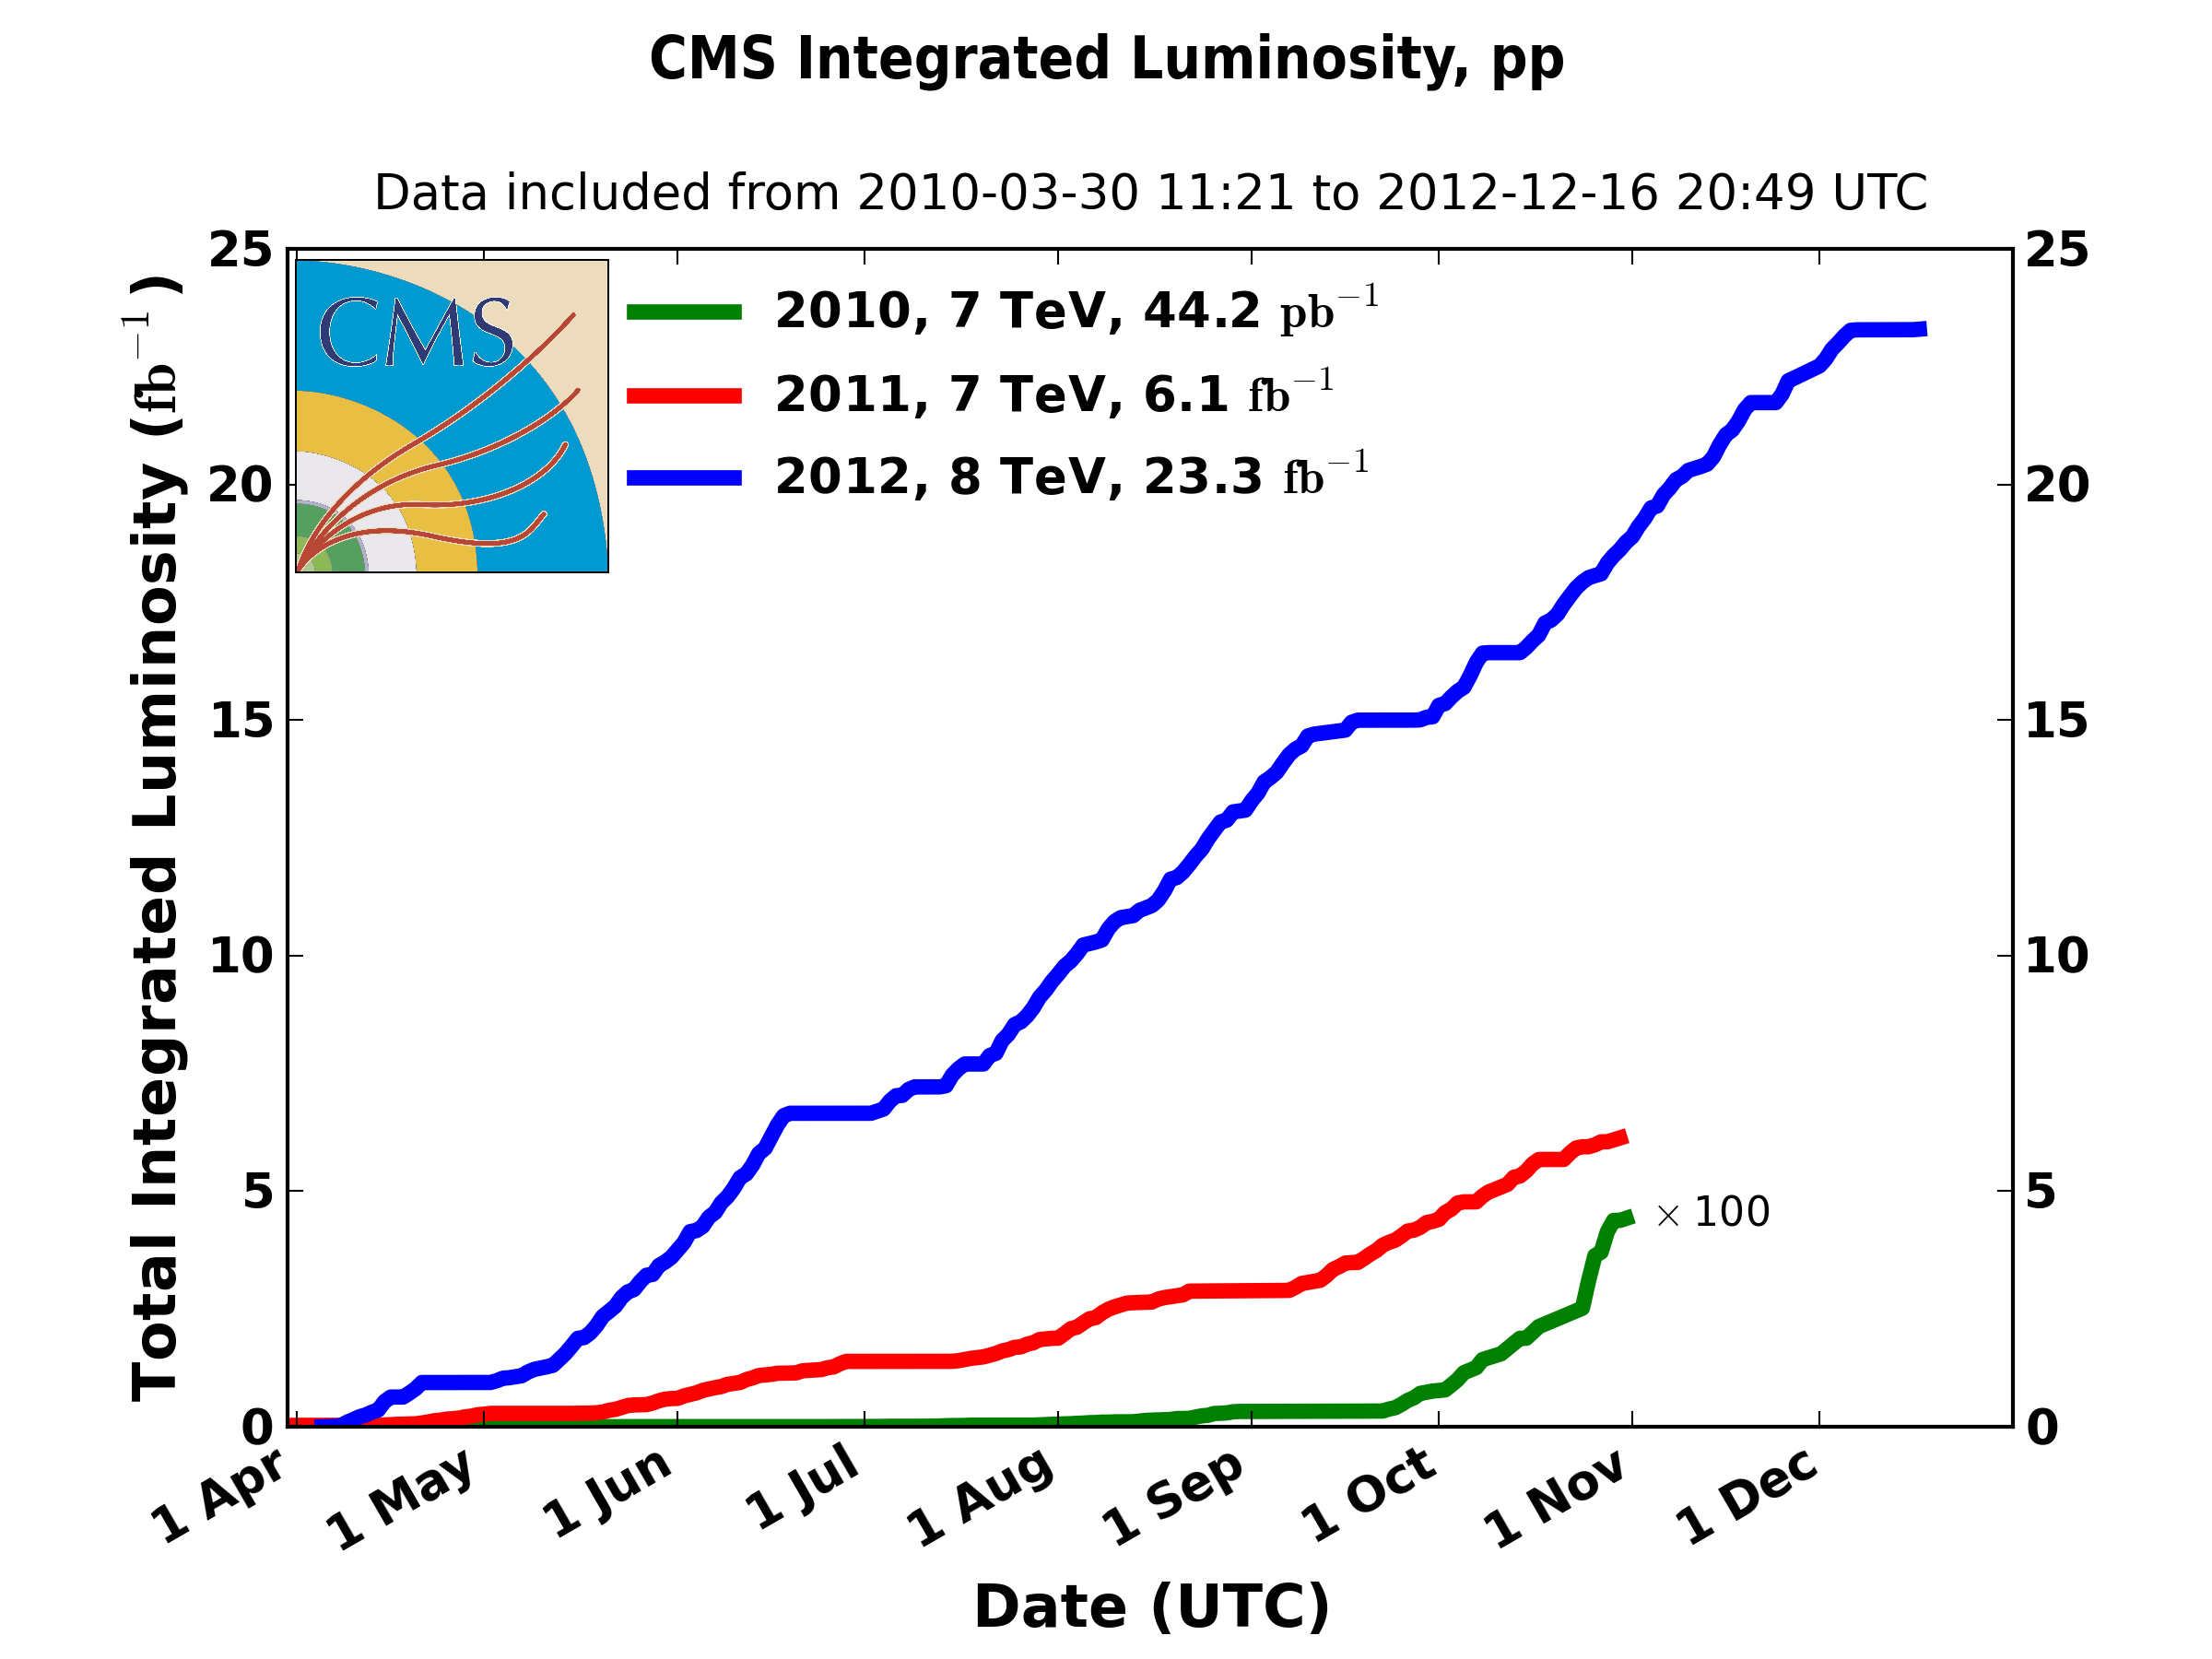
The Run-1 of the LHC
The Run-1 of the LHC ended in February 2013
During three years, CMS recorded ~5fb⁻¹ of pp collisions at 7TeV and ~20fb⁻¹ at 8TeV

Slide 6
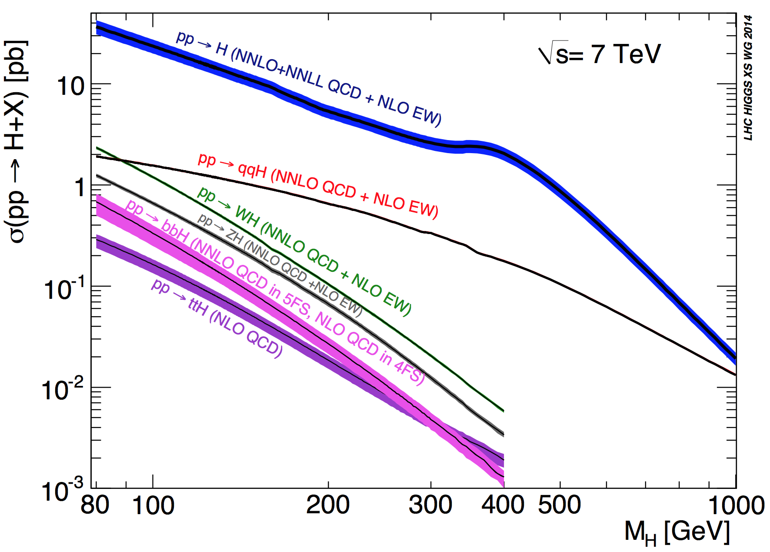
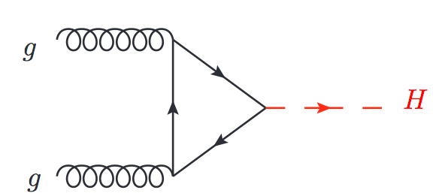
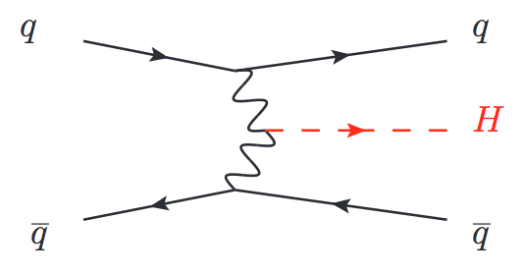
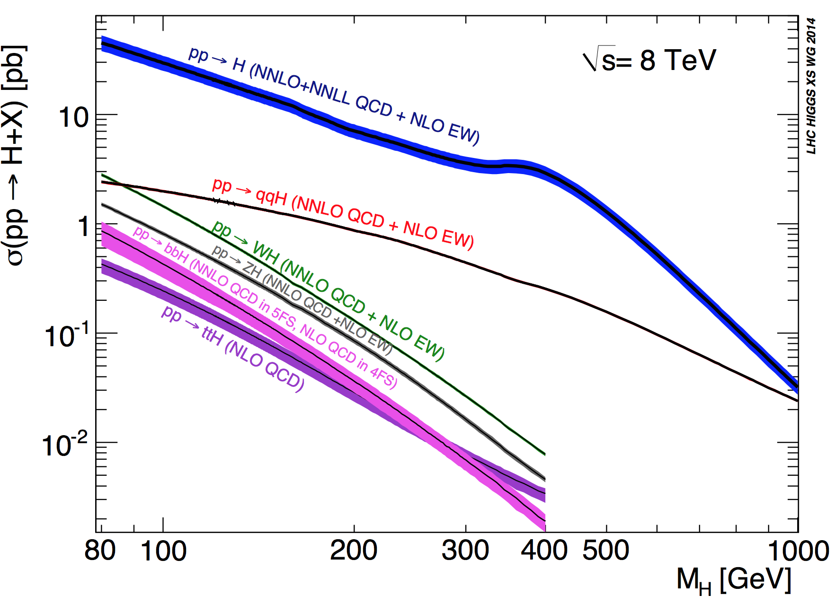
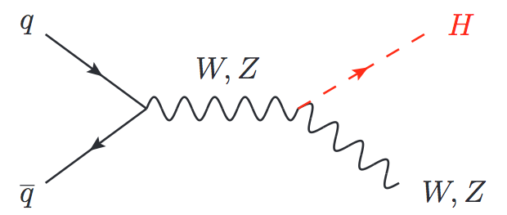
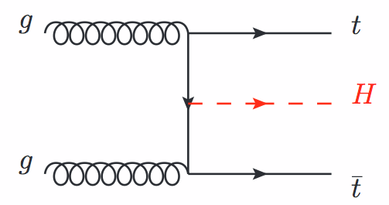
Higgs production at the LHC
Gluon-gluon fusion (ggH)
Dominant mode
No hadronic activity
Vector Boson Fusion (VBF) 2 forward jets
Associated production with a W or a Z boson (WH,ZH)
Associated production with a top/anti-top pair (ttH)

Slide 7
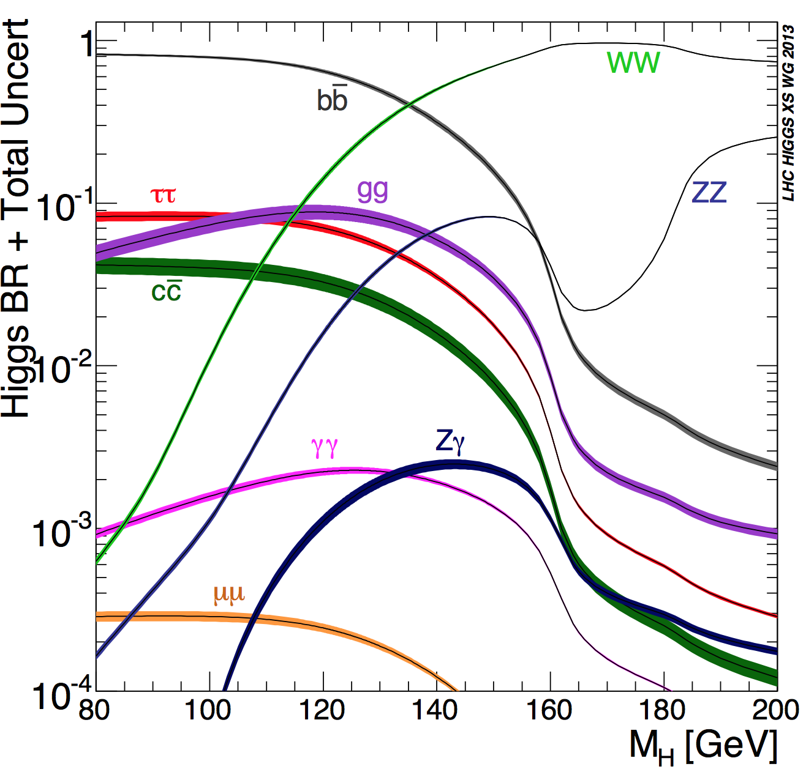
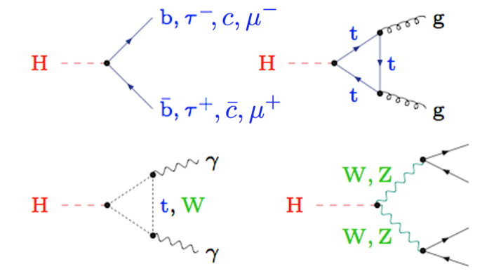
Higgs decay channels
Discovery decay mode → balance between Branching Ratio and clear experimental signature
H→ZZ→4l
Very clean experimental signature
H→γγ
Mass peak reconstruction
H→WW→2l
Clear experimental signature, no mass peak
H→ ττ
Accessible via VBF
H→ bb
Highest BR for low masses. Challenging experimentally

Slide 8
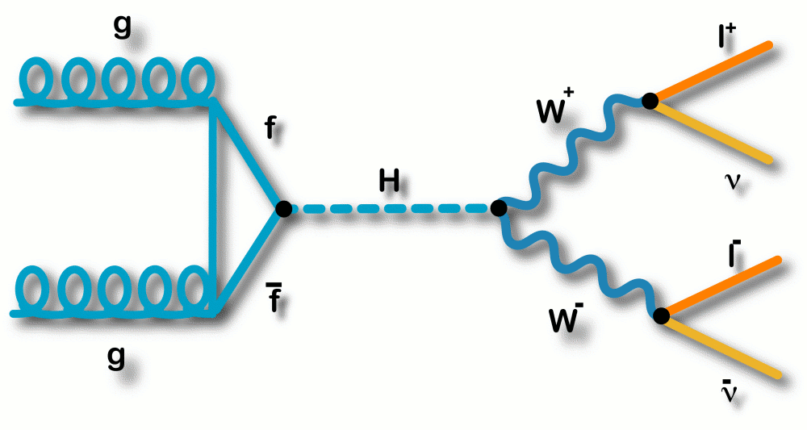
Why H→WW?
Sensitive in the intermediate mass range [120-200]
2^{d} largest BR around 125 GeV → BR _{H→WW} ~ 22%
Clear signature in leptonic decays (BR_{W→lν} ~ 10%)
Not possible to reconstruct full final state due to the neutrinos, no mass peak
Large background contribution (genuine and instrumental)
WW (irreducible), top, Drell-Yan, W+jets, QCD…
Two isolated leptons (e,µ) with opposite charge
Substantial missing energy (two neutrinos in the final state)
Depending on the production mode
ggH → little to no jet activity
VBF has 2 forward jets
+ other production modes (VH, ttH) provide even
more specific signatures (not covered today)

Slide 9
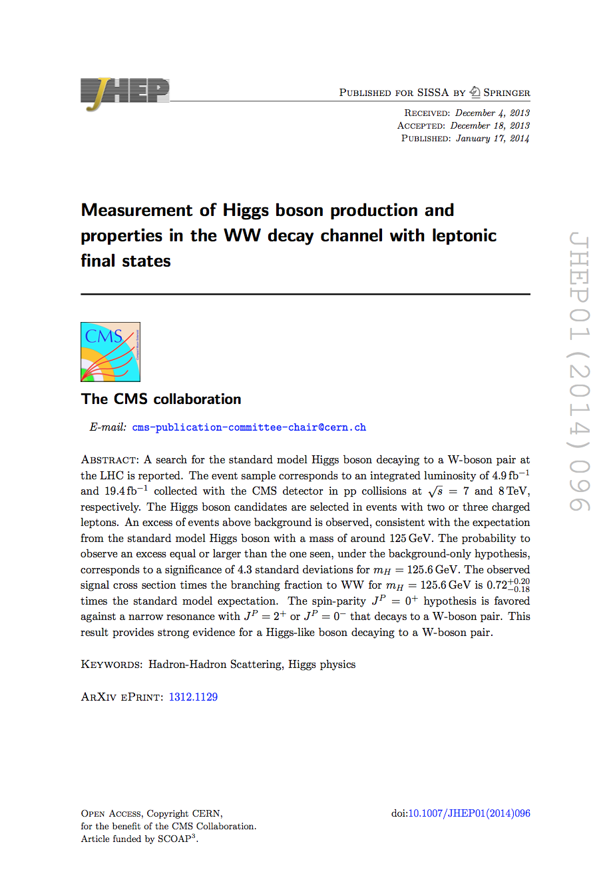
Legacy publication
The final Run-1 word from CMS in this decay channel uses the full dataset at 7 and 8 TeV and was published in JHEP in January last year:
Several processes were studied in detail, ggH, VBF, WH, ZH in 2 and 3 leptons signatures
The main analysis, that drives the sensitivity for this decay, is the, H→WW→eνµν in events with 0/1-jets (ggH), and it is the one that we will discuss in this presentation
H→WW legacy paper
arXiv:1312.1129
JHEP 01 (2014) 096

Slide 10
Physics Objects
Events are selected using single and double lepton triggers
Single: e 17-27 GeV µ 17-24 GeV
Double (ee,eµ,µµ): 17, 8 GeV
The analysis uses leptons, missing transverse energy, jets and b-jet identification
Leptons
Against backgrounds without two prompt leptons (W+jets, QCD…)
Selected following specific quality criteria, isolated
Electrons |η| < 2.5
Muons |η| < 2.4
Jets
Backgrounds with high jet multiplicity or with central jets (ttbar)
Anti-k_{t} 0.5, p_{T} > 30 |η| < 4.7

Slide 11
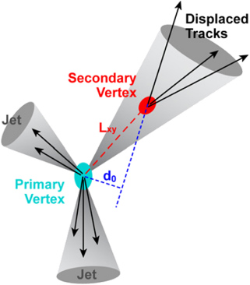
Physics Objects
b - jet identification
For jets coming from b-decays (ttbar, tW)
top quarks decays ~100% of times as t→Wb
Two tagging techniques, taking advantage of the properties of b-jets: B hadrons fly a few mm before decaying; and in ~40% of cases, B hadron decays include a soft lepton (e/μ) from b→l or b→c→l
b-tag algorithm based on lifetime
soft muon identification: p_{T}> 3 no isolation
rejects 70% b-quark jets, keeps 95% of light quarks

Slide 12
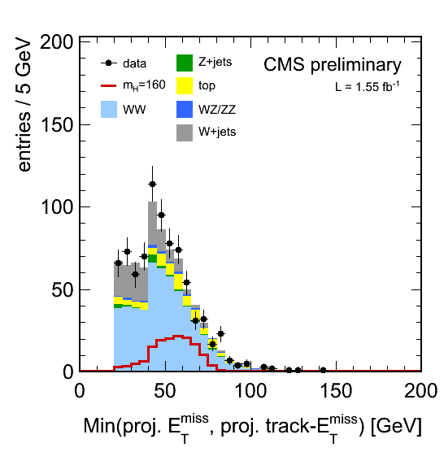
Physics Objects
Missing transverse energy (MET)
Against backgrounds with no genuine MET (Drell-Yan→l⁺l⁻)
different estimators
Particle Flow MET (PF MET), which uses all CMS detector subsystems and reconstructs a full list of stable particles
Tracker MET, that uses charged particles only, and it is less dependent on pileup effects
Projected MET = MET*sin[min(π/2,ΔΦ_{MET-closest lepton})]
MET estimator: min 2 projected MET quantities, PF and Tracker MET
PAS HIG-11-014

Slide 13
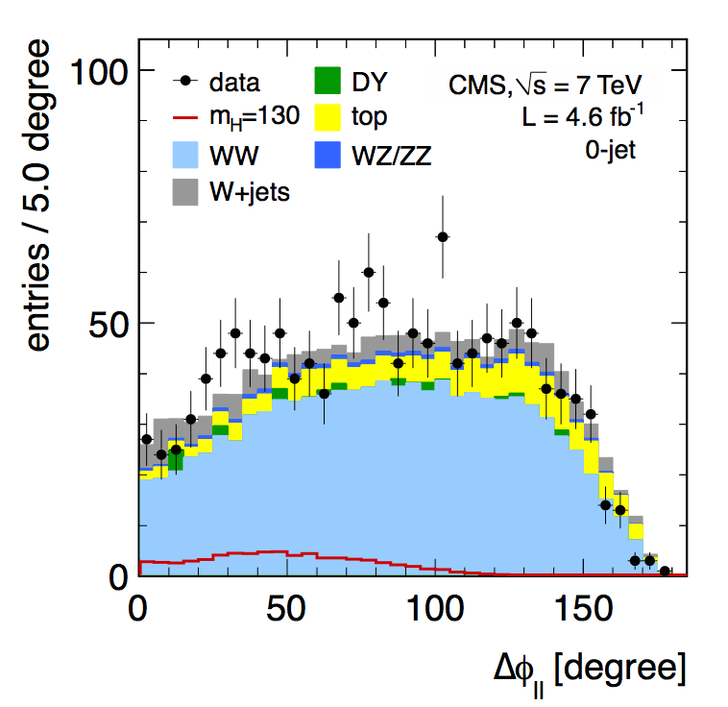
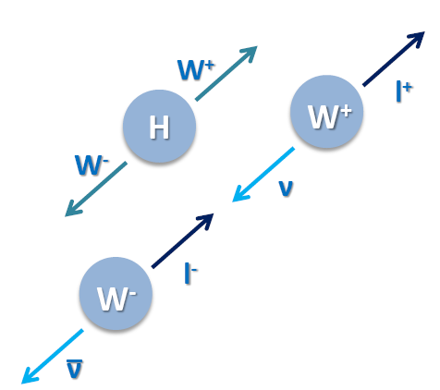
Kinematics of the signal
Some backgrounds have the exact same final state
WW→2l2ν is the clearest case and the almost irreducible one
There are three main observables to separate the signal from backgrounds:
ΔΦ_{ll}: opening angle between the two leptons in the transverse plane to the beam, correlated to the spin of the Higgs boson
7 TeV paper
data

Slide 14
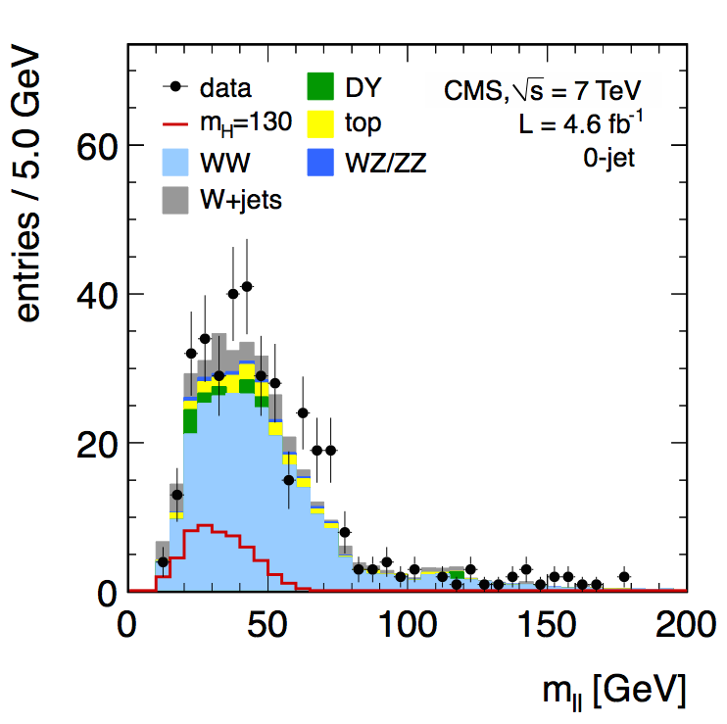
Kinematics of the signal
Some backgrounds have the exact same final state, WW→2l2ν is the clearest case and the almost irreducible one
There are three main observables to separate the signal from backgrounds:
ΔΦ_{ll}: opening angle between the two leptons in the transverse plane to the beam, correlated to the spin of the Higgs boson
m_{ll}: the dilepton mass, one of the most discriminating kinematic variables for a Higgs boson with low mass, in particular against Z/γ∗→ ll
7 TeV paper eµ

Slide 15
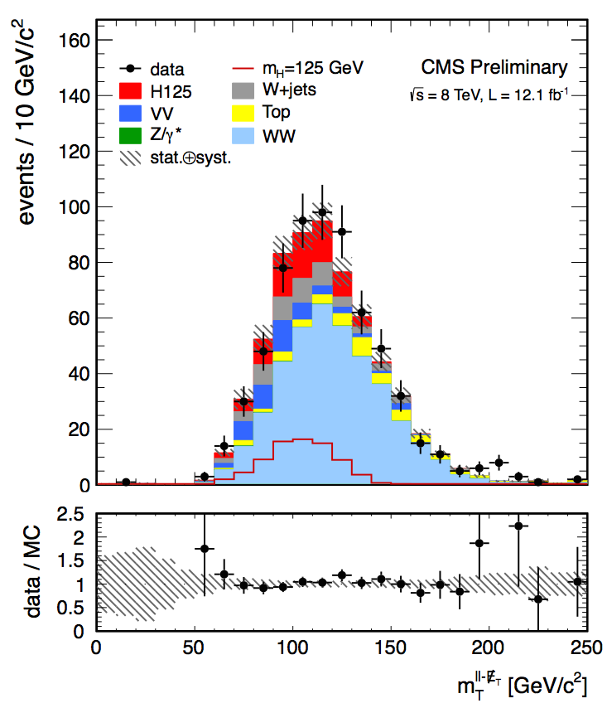
Kinematics of the signal
Some backgrounds have the exact same final state, WW→2l2ν is the clearest case and the almost irreducible one
There are three main observables to separate the signal from backgrounds:
ΔΦ_{ll}: opening angle between the two leptons in the transverse plane to the beam, correlated to the spin of the Higgs boson
m_{ll}: the dilepton mass, one of the most discriminating kinematic variables for a Higgs boson with low mass, in particular against Z/γ∗→ ll
m_{T}: the transverse mass of the final state objects which scales with the Higgs mass defined here as
PAS HIG-12-042
H→WW PAS for HCP 2012

Slide 16
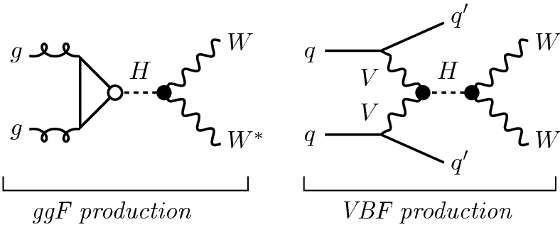
Definition of the WW selection
Exactly two leptons, eµ, with opposite charge, p_{T} > 20, 10 GeV
MET estimator > 20 GeV
Exactly 0 or exactly 1 jet
A region with: reasonable S/B and a good description of background
m_{ll} > 12 GeV
p_{T}^{ll} > 30 GeV
m_{T} > 30 GeV
Veto events with b-jets (b-tagging and soft µ)
For the same flavor (ee/µµ) case, additional cuts around the Z mass peak, and for other production modes different cuts are applied, like VBF (the second most important) that has cuts on ΔΦ_{ll-jj}, Δη_{jj} or m_{jj}

Slide 17
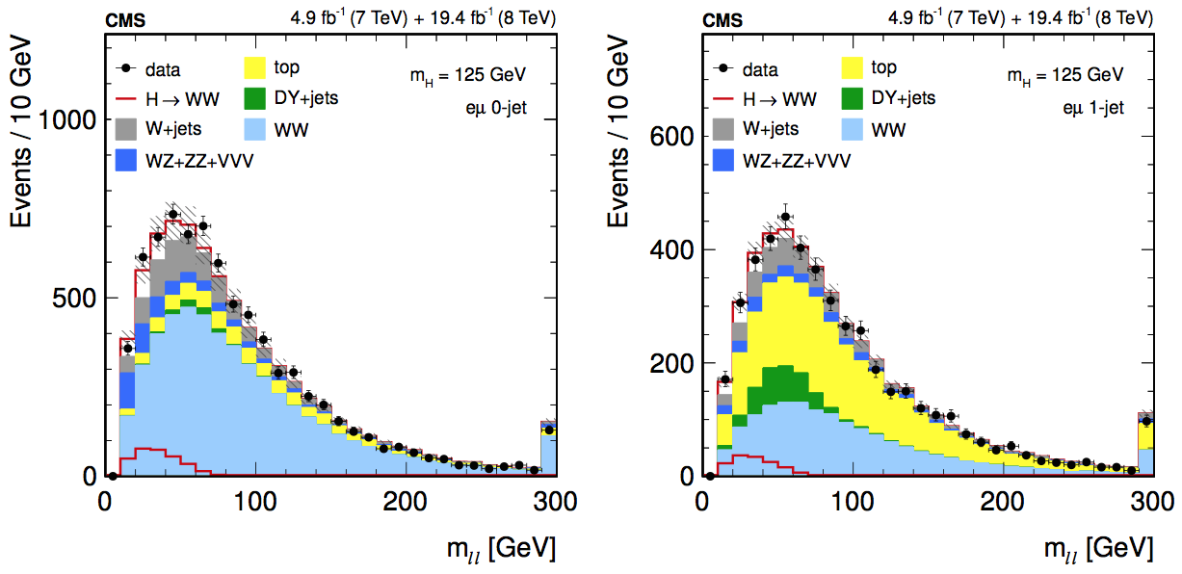
Analysis
m_{ll} at the WW selection level
After the WW selection, the analysis is split in categories and has different approaches depending on the final state (e.g. cut-based for ee and µµ)
The (ggH, eµ) analysis is based on a 2D shape analysis of m_{T} - m_{ll}, with 9 bins for m_{ll}, and 14 for m_{T}
m_{ll} [12,200], m_{T} [60,280] for m_{H} <= 250 GeV
m_{ll} [12,600], m_{T} [80, 600] for m_{H} > 250 GeV

Slide 18
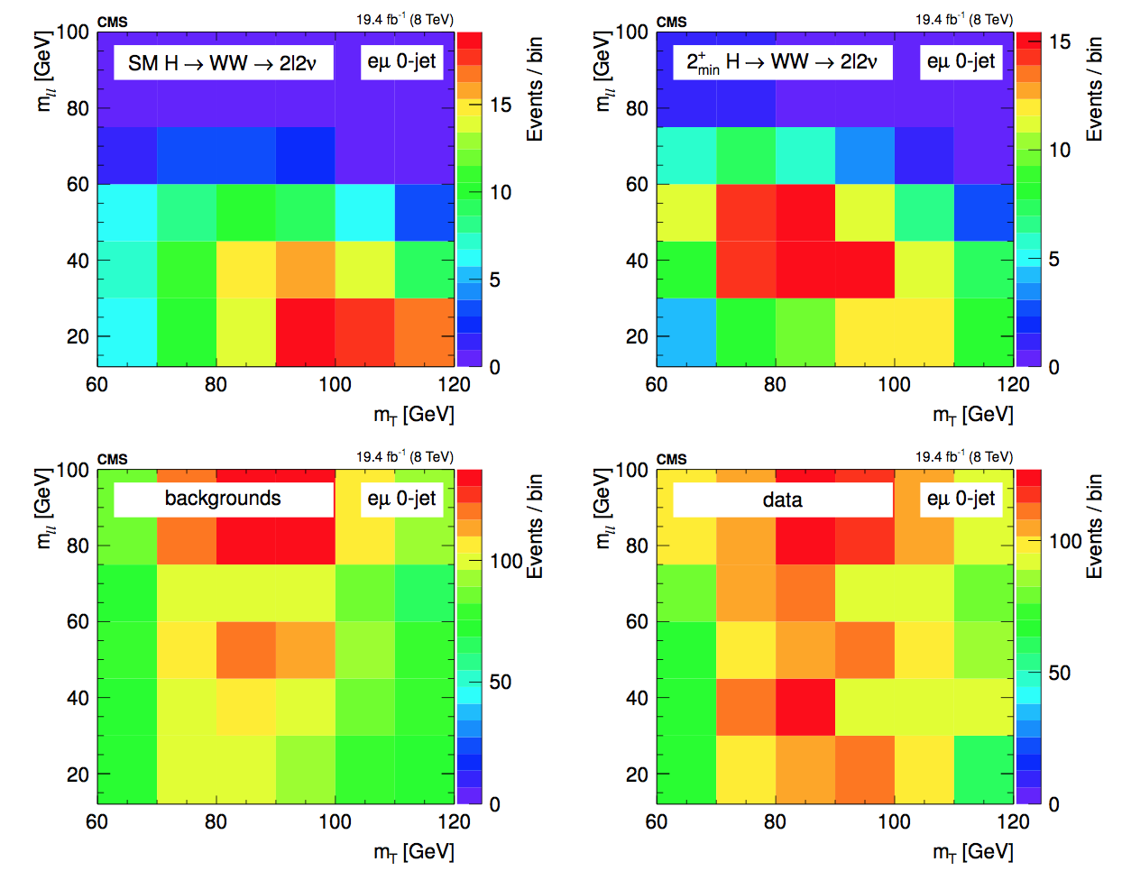
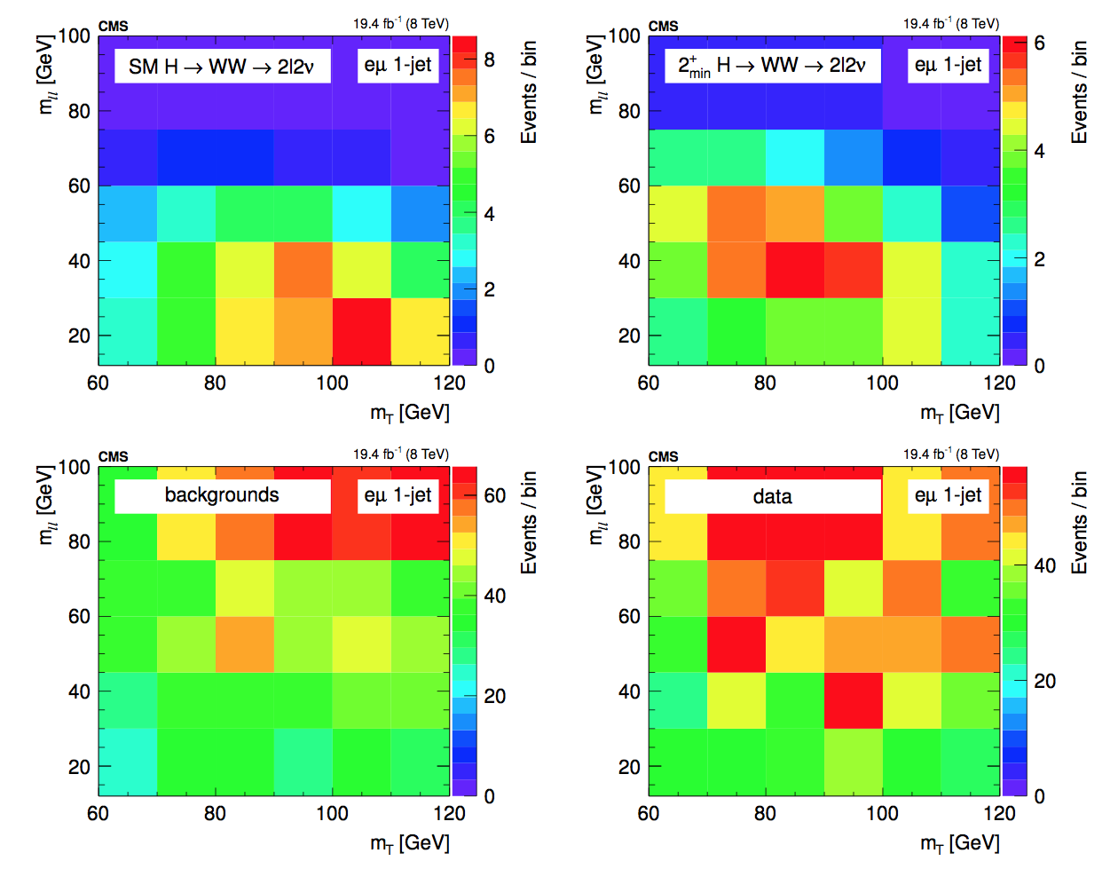
2D templates
A binned template fit is performed in this case to extract upper limits and significance

Slide 19
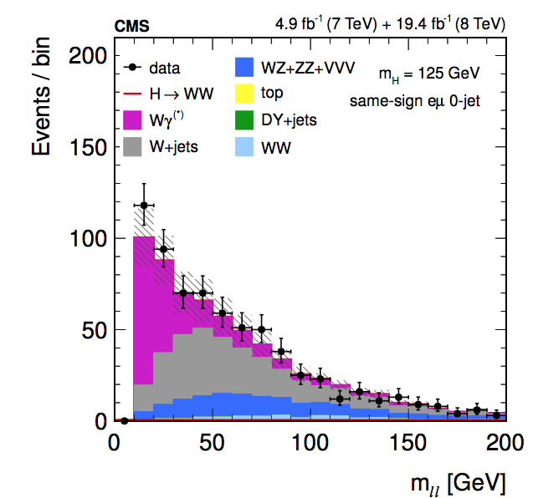
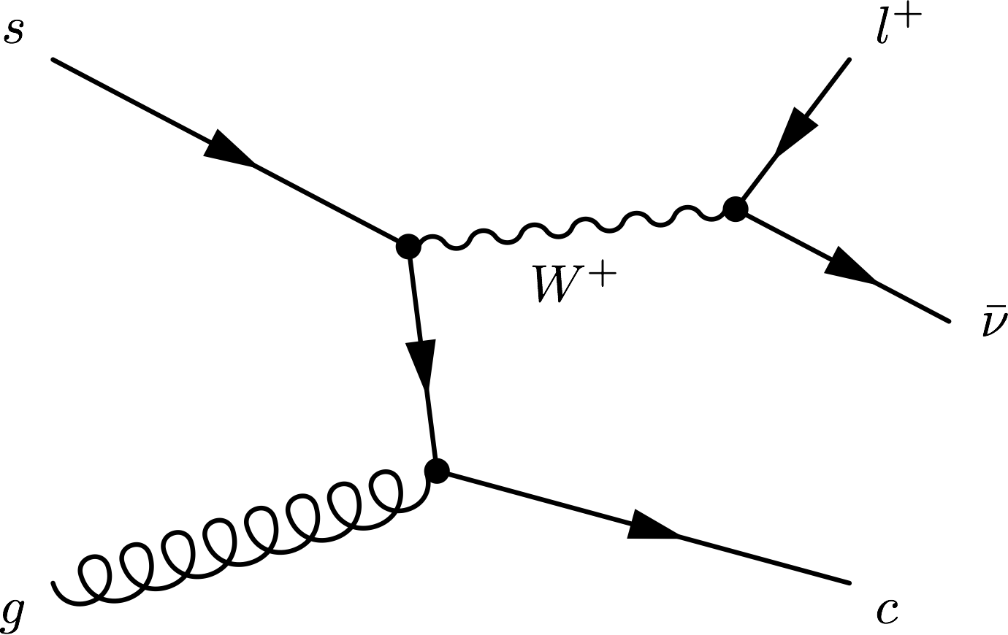
Background estimates
Central part of the analysis, data-driven as much as possible
Non-prompt leptons (W+jets, QCD): Leptonic decays of heavy quarks, hadrons misidentified as leptons, electrons from photon conversions.
Drell-Yan: in same flavor final states
shapes from simulation, normalization from data around the Z mass peak
WZ,ZZ,VVV: simulation
Fully data-driven: normalization and shapes
Pass-fail sample reweighed by pass efficiency estimated in data (multijet)
Closure test in simulation, validated in same-sign region (dominated by W+jets and Wγ(∗) )
Potential “fake” lepton

Slide 20
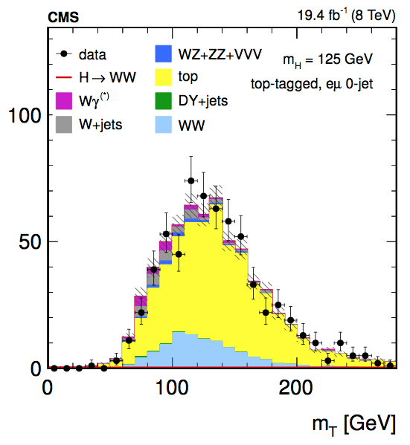
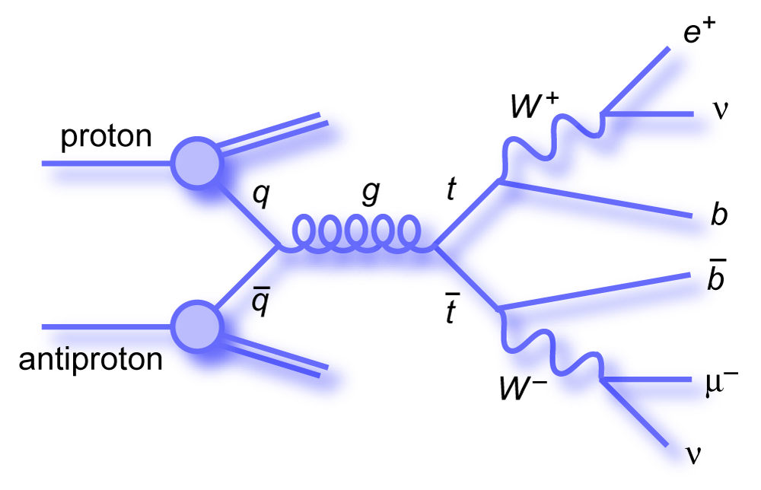
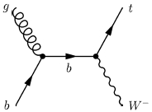
Background estimates
Top: Events from ttbar and single top tW
Shapes from simulation, normalization from data
Using top tagged events rejected in the analysis, weighted by efficiency measured in control regions with additional jets
Fit validated using top tagged events.
Wγ*: shape from simulation, normalization from data
part of WZ not properly modeled → low m_{ll} events where 1 lepton is lost simulated sampled compared with data in CR defined by different cuts (k-factor obtained)
Wγ: shape from data, normalization from simulation
data γ+lepton events reweighed with ratio γ->lepton

Slide 21
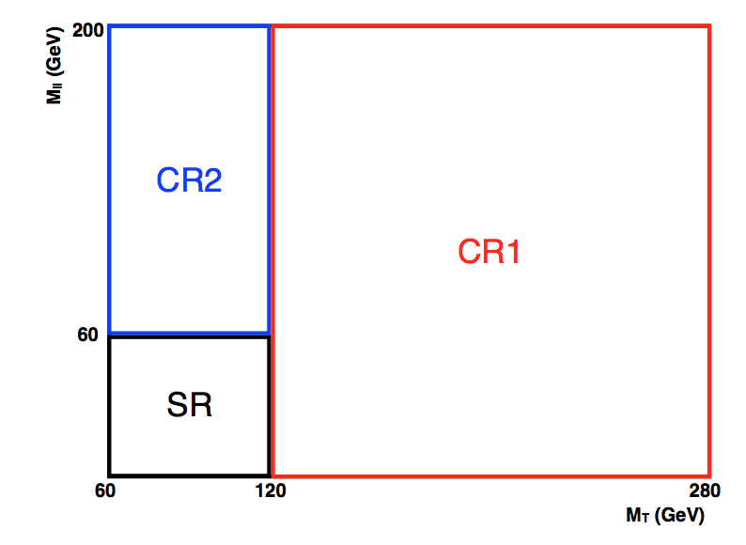
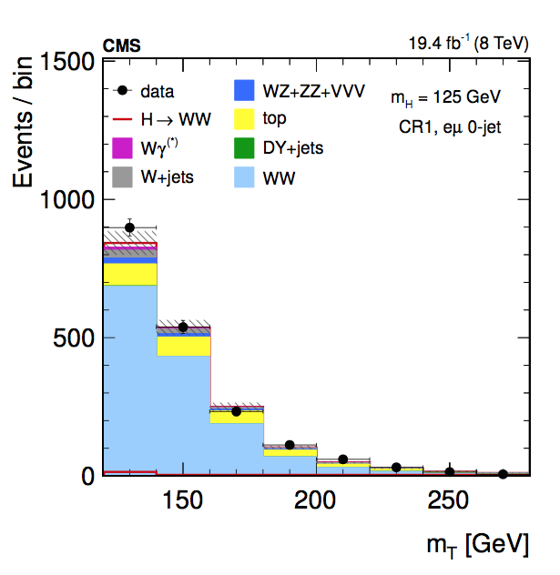
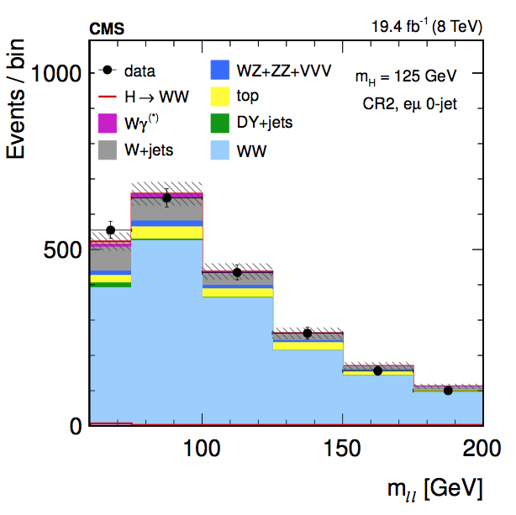
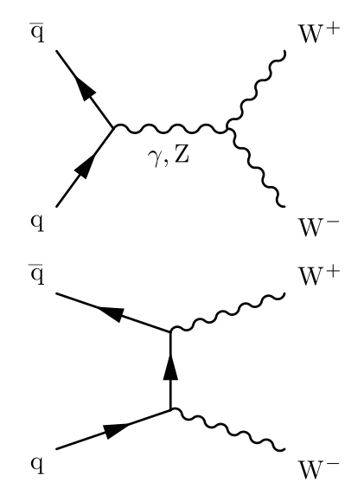
WW Background
Fit validated in two control regions, similar statistics, purity 70-75%
output of fit in one extrapolated to the other:
high m_{T} CR1: 120 < m_{T} < 280 and 12 < m_{ll} < 200
high m_{ll} CR2: 60 < m_{T} < 120 and 60 < m_{ll} < 200

Slide 22
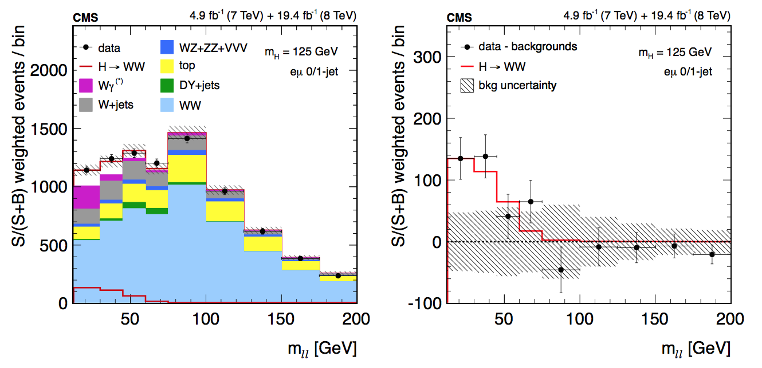
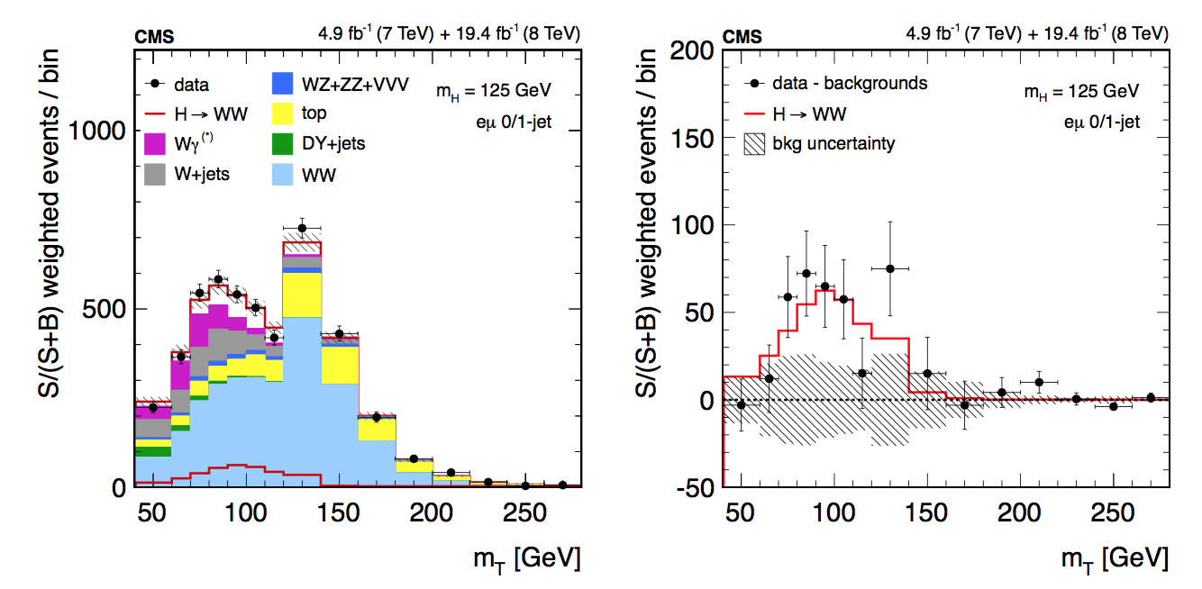
Final distributions
Data compared with signal and background events
Background-subtracted data compared with best-fit signal component

Slide 23
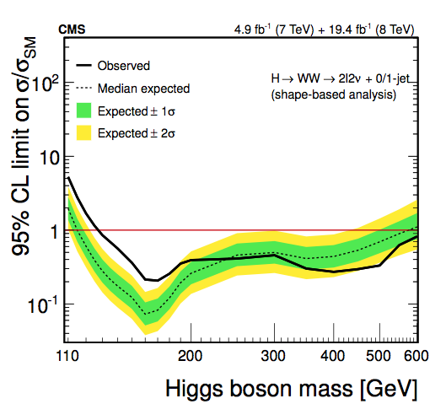
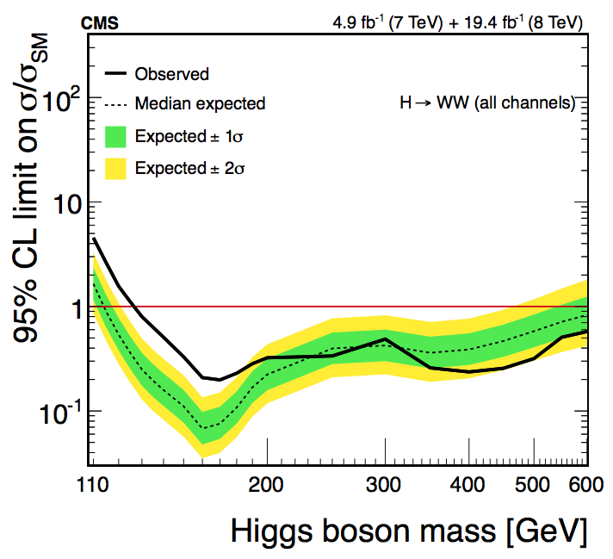
Results
The eµ channel alone:
95% CL |  | Significance |  | σ/σ_{SM}
Exp. | Obs. | Exp. | Obs.
0.4 | 1.2 | 5.2 | 4.0 | 0.76±0.21
Full H→WW result
Significance |  | σ/σ_{SM}
Exp. | Obs.
5.8 | 4.3 | 0.72+0.20-0.18

Slide 24



There is definitely something
Something that decays via X→WW→2l2ν
There is confirmation from other decays (in some decays stronger than in WW, in other decays less so)
But is it the Higgs?
Handles to find deviations with respect to the SM expectations:
Mass, Charge, Spin, Parity…
→ How much can we explore using H→WW?
SM prediction
Reality?
Reality?

Slide 25
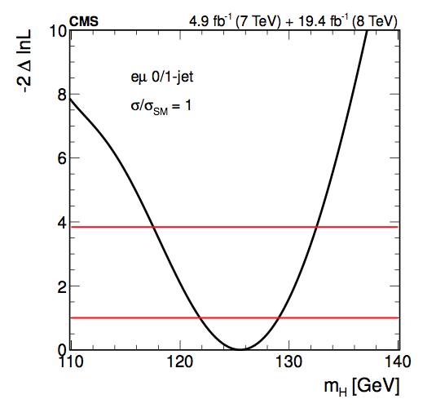
Charge
The charge is 0, it is a neutral particle.
The H→WW excludes a Higgs mass range from 127 to 600 GeV
Expected range extends from 115 to 600 GeV
Additional Higgs bosons with SM-like properties excluded in the mass range 114–600 GeV assuming a 125 boson
Best-fit mass:
σ/σ_{SM}=1 → m_{H} = 125.5+3.6−3.8 GeV
without the constraint → m_{H} = 128.2±6.6 GeV
Mass
Legacy mass paper
arXiv:1412.8662
Accepted by JHEP
Submitted Dec 2014
CMS Higgs mass value (driven by γγ and ZZ):
m_{H} = 125.02 +0.26-0.27 (stat) +0.14-0.15 (syst)

Slide 26
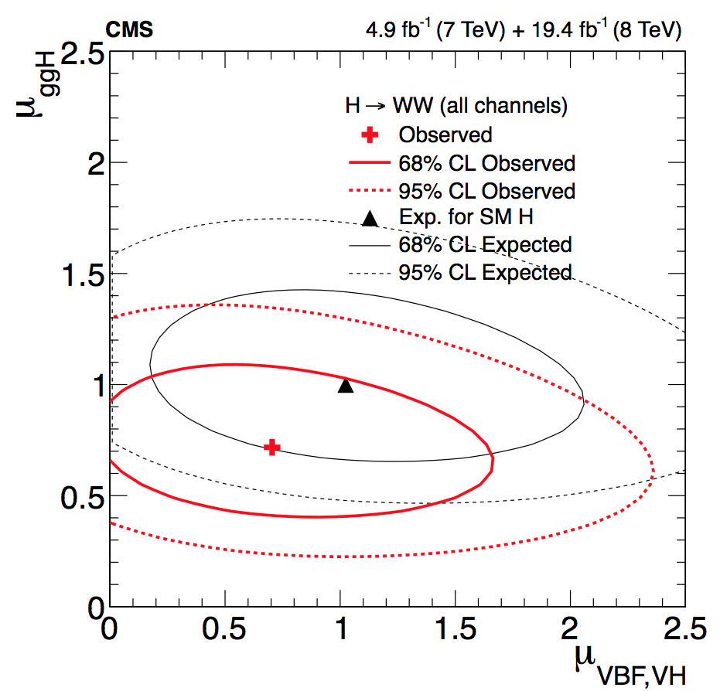
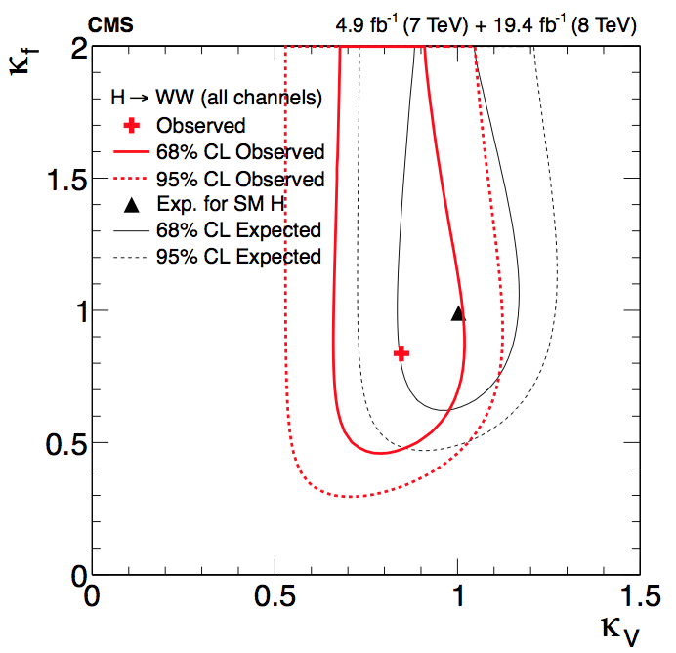
Couplings
The values of µ_{ggH} and µ_{VBF} can be used to test the fermionic and bosonic couplings
Coupling modifiers κ_{V} and κ_{f} are assigned to vector and fermion vertices → used to scale the expected product of σxBR to match the signal yields observed in data
κ_{i} is κ_{f} for ggH, κ_{V} for VBF; and κ_{H} is the total decay width ~ κ_{f}²
µ_{ggH} is sensitive to κ_{V} and µ_{VBF}, which scales with κ_{V}⁴/κ_{f}² is more sensitive to κ_{f}

Slide 27
Spin and parity
arXiv:1411.3441
Submitted to PRD
November 2014
Information from angular distributions of the decay products:
For example, in H→ZZ→4l, the final state is reconstructed fully and accurately
In H→WW the final state is not fully reconstructed, and there is more background contamination in the signal region, however
There is potential gain in the combination of HWW with other final states
We extract all the possible information using the same templates used for the SM Higgs search
Interpretation of the signal events in terms of
Hypothesis test of SM against exotic spin-1 and spin-2 Higgs boson, using the same model as in the SM Higgs search and the test statistic q = -2ln(L_{JP}/L₀₊) to quantify the consistency of the two models with data
Anomalous couplings with respect to SM of a spin-0 Higgs boson using fractions of cross sections

Slide 28
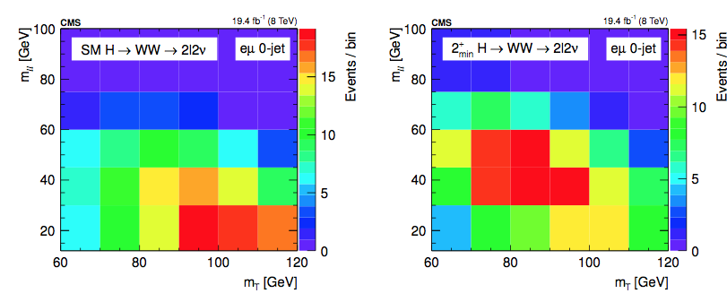
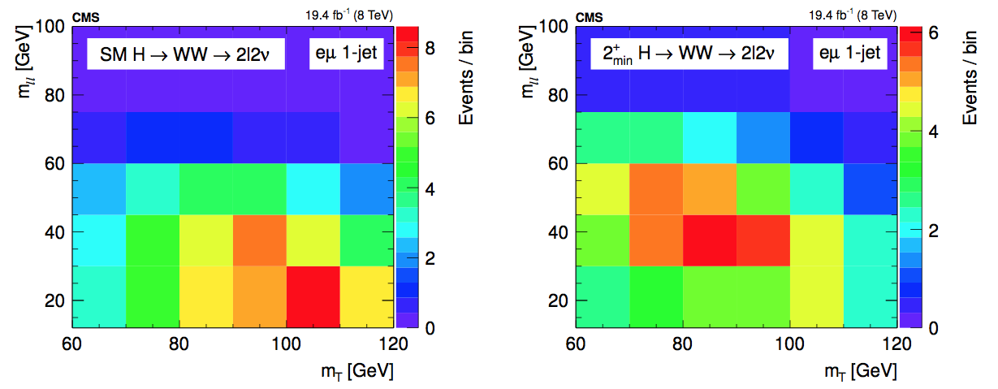
Spin studies in H→WW
The same 2D templates used in the eµ analysis are also optimal to discriminate between different spin hypotheses

Slide 29
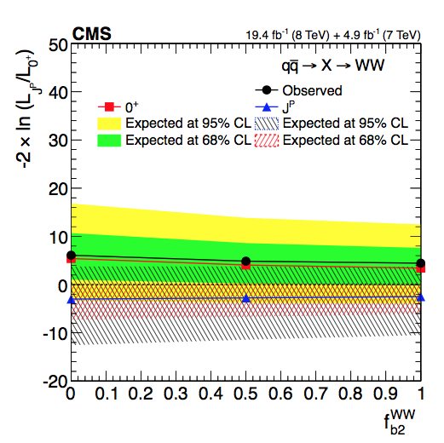

Spin-1
J=1 not allowed for X→𝛾𝛾 by the Landau-Yang theorem
Still we tested experimentally potential spin-1 models (in the hypothesis the excess is not the same resonance as 𝛾𝛾) in H→WW: J^{P}=1⁻, 1⁺ and a mixed case

Slide 30



Spin-2
J=2 tested for different production modes (gg, qq), ten different models tested, separation studied as a function of the qqH component, f_{qq}
In all cases the data favor the SM hypothesis over the alternative spin-one or spin-two hypotheses

Slide 31

H→WW and H→ZZ combination
The main player in separating exotic spin hypotheses is the H→ZZ decay, but H→WW contributes to the combination
All the exotic models are excluded at more than 99.9% CL
(It is a spin 0 boson)

Slide 32

Spin 0 amplitude in H→VV
The observed Higgs boson appears to be predominantly a J^{CP}=0⁺⁺ state
It still could be a mixture of CP states and the couplings to gauge bosons could have small anomalous components
The decay amplitude for a spin-0 boson to a pair of V bosons (V = Z, W, g, γ) is defined, up to dimension 5, as:
a1 is the SM amplitude
Λ1 is a higher-term of an expansion in momentum
a2 and a3 control the CP-even and CP-odd amplitudes

Slide 33


Spin 0 amplitude in H→VV
We choose a parameterization that relates fractions of the cross sections to the couplings: f_{a2}, f_{a3}, f_{Λ1}
Given the measured value of f_{x}, it is possible to extract the coupling constant:
Where f_{a1} = 1-f_{a2}-f_{a3}-f_{Λ1}-…, is the SM contribution, which is expected to dominate
σ_{i} is the effective cross-section when a_{i} = 1 and a_{j≠I} = 0

Slide 34




H→WW Spin-0 studies
The likelihood scans for the effective fractions are consistent with the SM
H→WW has limited sensitivity for the measurement of f_{a2}, f_{a3} and f_{Λ1}
When combined with H → ZZ there is a sizeable improvement on the sensitivity
Couplings constrained to be real and all other anomalous couplings are fixed to the SM predictions in each case, cos φ term allows a signed quantity where cos φ = −1 (π) or +1 (0)

Slide 35


H→WW and H→ZZ combination
General relationship between HWW and HZZ couplings: a_{i}^{WW}/a₁^{WW} = r_{ai} (a_{i}^{ZZ}/a₁^{ZZ} )
We have two scenarios for combination: arbitrary relationship between W and Z couplings or custodial symmetry
r_{ai} [−∞, +∞]
R_{ai} [−1,+1]
a₁^{WW} ≠ a₁^{ZZ}
a₁^{WW} = a₁^{ZZ}

Slide 36

H→WW and H→ZZ combination
Choosing R_{a2}=0.5 (r_{a2}=1) for illustration purposes.
Not assuming custodial symmetry the result is close to the sum of the two individual curves, as expected. In the custodial symmetry scenario greater exclusion is achieved because the yields are related in WW and ZZ:

Slide 37


Summary of anomalous couplings
Consistent with SM. When assuming custodial symmetry: pure 0_{h}⁺ excluded at 99.93% CL and pure 0⁻ excluded at 99.99% CL
Summary of allowed confidence level intervals on anomalous coupling parameters in HVV interactions under the assumption that all the coupling ratios are real

Slide 38

So, it is the Higgs?
We have a new particle that decays like the SM Higgs would
With a mass ~ 125GeV
Neutral
Scalar couplings to fermions and vector bosons compatible with a SM Higgs
J^{CP}=0⁺⁺
Is this guy exactly as we expect it?
Looks like it is from here

Slide 39

But only more data will tell

Slide 40
Backup

Slide 41



The CMS experiment at the LHC
The Large Hadron Collider (LHC) at CERN is the largest particle accelerator of the world. It has 4 big experiments (ALICE, ATLAS, CMS, LHCb), two of them (CMS and ATLAS) are intended for general purposes and complementary
Compact Muon Solenoid (CMS)
Total weight : 14,000 tonnes
Overall diameter : 15,0 m
Overall length : 28,7 m
Magnetic Field : 3.8 T
More than 2,600 people
41 countries

Slide 42


H→WW projections for 7 TeV
H→WW alone
Discovery level sensitivity (~5σ) : 160<m_{H}<170 GeV
Exclusion 95%CL: 150<m_{H}<185 GeV
Combination of the main modes
Expected exclusion 95%CL
145< mH <190 GeV

Slide 43


7 TeV results
arXiv:1202.1489
Phys. Lett. B 710 (2012) 91
(Submitted 7 Feb 2012)
arXiv:1202.1488
Phys. Lett. B 710 (2012) 26
(Submitted 7 Feb 2012)
At 7TeV H→WW excluded the mass range [129 - 270] GeV/c² at 95% C.L.
The combination excluded from 127–600 GeV/c² at 95% CL, the expected exclusion was 118–543 GeV/c²
An excess above the background was observed, the largest, with a local significance of 3.1 σ corresponding to a mass hypothesis of 124 GeV/c²

Slide 44

Systematic uncertainties

Slide 45

Event Yields

Slide 46
A bit more on the fit
Just a handful of nuisances where the uncertainty is reduced by more than 50% by the fit:
Related to WW, Top and a couple of experimental syst.
Fit was investigated in three ways:
with toys
cut-based does not constrain nuisances, the variations are accounted for by the signal
shape based does, pulls width ~1
Correlations → fit looses power, width < 1
interpretation of results in full HWW data card is non trivial
control regions
alternative pdfs for nuisances

Slide 47


Slide 48

Expected and observed likelihood profiles for for the three production modes separately

Slide 49

Signal strength
The signal strength quantifies the compatibility of the size of the excess observed with the expectation for a SM Higgs signal
σ/σ_{SM} value for m_{H} = 125.6GeV is 0.72+0.20 −0.18 = 0.72 ±0.12(stat.) +0.12 -0.10(th. syst.) ±0.10 (exp. syst.)
The results from all categories are consistent within the uncertainties

Slide 50

Spin-2 scenarios

Slide 51


Slide 52


Slide 53


Slide 54


Slide 55


Slide 56


